Slide 1

R Package Development and Validation
Package Documentation

Slide 2
Welcome
Documenting Functions with {roxygen2}
Long-form documentation in R packages
Checking your R package

Slide 3
Documenting Functions

Slide 4
?functionname
Notes:
What happens when you type that

Slide 5
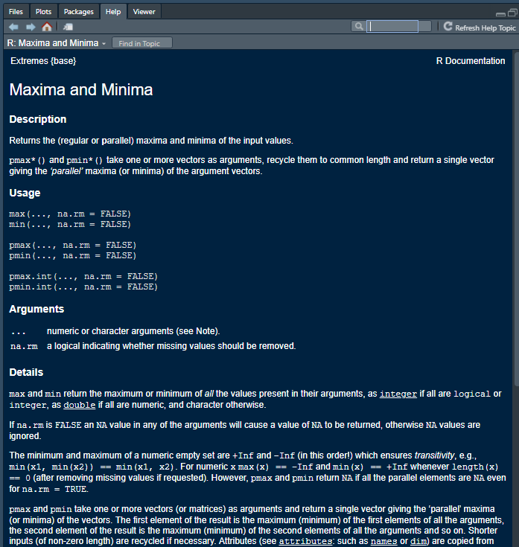
Function manuals
Describe the function
What does it do
What does it return
Identify arguments
What goes into the function
What are optional
Show examples

Slide 6
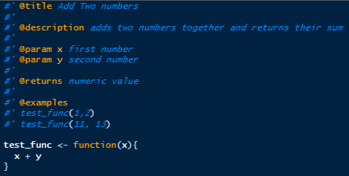
Roxygen2
INLINE with package
structured comments
Title
Description
Parameters (arguments)
Returns
Examples

Slide 7
Generate documentation
INLINE with package
structured comments
Title
Description
Parameters (arguments)
Returns
Examples

Slide 8
Vignettes

Slide 9
Share with the world how you expect everything to fit together

Slide 10
Check yourself

Slide 11
Making your Package

Slide 12
devtools::document()
Notes:
Creates a package folder with a _recommended_ set of files
- De

Slide 13
DESCRIPTION File
Basic package information – name, version, authors, dependencies
NAMESPACE File
What information does R need to know – Functions that are shared, dependencies, methods
R Folder (/R)
Folder to house the R code of the package
.Rbuildignore, .gitignore, .Rproj.user
Notes:
DESCRIPTION – Lots of “meta” information around the package
What the name of the package is, the version of the package, sentence summary and description
Who the authors and contributors are
Which packages this package Depends, Imports, Suggests, etc on
Any other software requirements
NAMESPACE – How should R handle your package
Which of your functions should it share out?
Which methods did you write – behaviors of objects
Which functions from the other packages does it need to load
R Folder
Store all your R functions here!
Misc files useful but not directly related to packages

Slide 14
devtools::test()

Slide 15
Creates a new R script
Within /R
Organize Code within R Script to be related
Give a meaningful name to the script
usethis::use_r(“new_file_name”)
Notes:
DESCRIPTION – Lots of “meta” information around the package
What the name of the package is, the version of the package, sentence summary and description
Who the authors and contributors are
Which packages this package Depends, Imports, Suggests, etc on
Any other software requirements
NAMESPACE – How should R handle your package
Which of your functions should it share out?
Which methods did you write – behaviors of objects
Which functions from the other packages does it need to load
R Folder
Store all your R functions here!
Misc files useful but not directly related to packages

Slide 16
devtools::check()

Slide 17
Creates a new test script for unit testing
Unit testing allows the developer to repeatedly test across all expectations
Creates tests/testthat folders
Creates new test within tests/testthat folder
Organize tests within to be related
usethis::use_test(“new-test-name”)
Notes:
DESCRIPTION – Lots of “meta” information around the package
What the name of the package is, the version of the package, sentence summary and description
Who the authors and contributors are
Which packages this package Depends, Imports, Suggests, etc on
Any other software requirements
NAMESPACE – How should R handle your package
Which of your functions should it share out?
Which methods did you write – behaviors of objects
Which functions from the other packages does it need to load
R Folder
Store all your R functions here!
Misc files useful but not directly related to packages

Slide 18
devtools
Automates workflows and creation of files and folders done as part of package development
Creating the R package skeleton – usethis::create_package()
Adding a license – usethis::use_license()
Create a new R script – usethis::use_r()
Add package to DESCRIPTION file – usethis::use_package()
Create a new test – usethis::use_test()
Create Vignette – useths::use_vignette()
usethis.r-lib.org
Notes:
We only covered a small % of the functinos available in usethis

Slide 19
Materials 02-E2
Materials/Materials-02-Package_Elements_and_Structure/Materials-02-E02-Package_Documentation/
Notes:
Now its your turn! We’ll give you 8 Minutes!

